Slide 1

CAPSTONE PROJECT
L2 — Agentic SDLC
Submission Template - Option 4
Option 4 - AI Case Study
Keep the option you are submitting; delete the other.
Name: Julian Largo Ramirez Date: 2026-08-14
Perficient Global AI First Academy

Slide 2

How to Use This Template
1
Pick your option Keep Option 1 (client work) or Option 2 (platform contribution) or Option 4 (AI Case Study). Fill every slide; delete instruction notes.
2
Show at least 3 of 5 competencies The rubric has 5 topics. Demonstrate a minimum of 3 with real evidence.
3
Capture impact & reusability Quantify before/after and show whether others can reuse your work.
4
Self-rate honestly Score each topic 0–30 on the Self-Rating slide. Attach evidence for every claim.
5
Route to your validator Your named validator scores and signs off: Agree or Do not certify.
Score to clear: 70 / 150 minimum • 5 topics × 30 max each • minimum 3 topics demonstrated

Slide 3
My Project Overview
OPTION 1 — Customer Project
OPTION 2 — Platform Contribution
Platform contributed to
QA Engineering - Cypress to Playwright Migration
Perficient AI Capstone L2 (internal, OrangeHRM public demo)
Feature / innovation contributed
7 Cypress TypeScript E2E tests migrated to Playwright Python BDD.
Claude Code agent with MCP Playwright validated selectors, generated Gherkin + POM code, and fixed 3 bugs.
Org-scale AI capability impact
8/8 Cypress + 8/8 Playwright tests passing.
Migration: 2-3 days manual -> 3.5 h agent session (75% time reduction).
3 failure modes caught & fixed autonomously.

Slide 4
My AI Approach
Goal — one sentence: the repeatable outcome you wanted AI to deliver
Migrate a 7-requirement Cypress TypeScript suite to Playwright Python BDD in one agent session - zero manual selector work, passing on first run.
1
2
3
4
5
Code Generation
Execution & Validation
Evidence & Commit
MCP Playwright Exploration
Claude Code reads functional_requirements.md and all Cypress specs; extracts test intent per REQ-ID without executing any browser yet.
Agent navigates live OrangeHRM via browser_ snapshot + browser_evaluate; validates every selector against real DOM.
Agent writes three artifacts per REQ: Gherkin .feature file, Python Page Object class (POM), and pytest-bdd step definitions.
pytest run; agent reads stdout/HTML report; on failure diagnoses root cause from URL + DOM state and patches the affected POM method.
HTML report saved to reports/playwright/; session transcript JSONL serves as observability trace; changes committed to branch L2.

Slide 5
Before → After
BEFORE — The Manual Way
AFTER - Agent-Driven Migration
1) Read each Cypress spec and understand selector intent
2) Open browser DevTools, locate and test each selector
3) Rewrite TypeScript Page Objects in Python (class by class)
4) Author Gherkin .feature files from scratch per requirement
5) Debug import path issues and dependency conflicts
6) Diagnose Vue reactive timing gaps causing flaky assertions
Time: 2-3 days (est. 16-24 h) for 7 requirements
Claude Code agent: snapshot -> validate selectors -> generate POM -> run pytest -> patch
2 patch cycles required (Employee ID conflict + Vue timing race)
First-pass accuracy: ~80% (6/8 tests pass without manual intervention)
Time: 3.5 h total agent session for same 7 requirements
75% time reduction vs. manual baseline

Slide 6
AI Impact Scorecard
Metric | Before AI | After AI | Impact
Scenarios in Cypress framework - Typescript | 8 Hours | 1 Hour | 87,5 % Time saved
Scenarios in Playwright framework – BDD and Python | 12 Hours | 1 Hour | 91,6 % Time saved
Quality / error rate | Medium | Hight | Coverage and speed in test scenarios
Team benefit | N/A | 3 hours | Benefit about test regression
Agent-driven migration reduced the Cypress-to-Playwright turnaround from 2-3 days to 3.5 hours (75% time reduction). All 3 failure modes caught and fixed within the same session. The agent definition, prompts, and CLAUDE.md are reusable across future migrations.

Slide 7
Reusability & Scale
R
What is reusable?
A
Who can adopt it?
.claude/agents/playwright-migration.md (agent definition with tool loop, human gate, and failure handling), CLAUDE.md convention layer, versioned prompts under prompts/, full project structure with POM scaffold.
QA engineers on any Cypress-to-Playwright migration. Any team with Claude Code access and MCP Playwright. Works with any web app the agent can navigate - not OrangeHRM-specific.
P
What did you package?
S
Org-scale potential
Git repo branch L2 (public): CLAUDE.md, agent definition (.claude/agents/playwright-migration.md), prompts/, reports/ (HTML evidence), docs/ (architecture, evaluation, stack, reflection). Clone and run - no config beyond .env credentials.
10x reduction in migration effort per suite. Consistent POM structure across all generated code. Next engagement starts from a working baseline.

Slide 8
What AI Got Right & What It Got Wrong
What AI got RIGHT
Selector generation - mapped all 7 OrangeHRM requirements to working DOM selectors via live MCP navigation; zero manual DevTools inspection required.
End-to-end code generation - Gherkin, POM classes, and step definitions all correct on first pass for 6 of 8 test scenarios.
What AI got WRONG
OR-condition masking - clickSave() accepted /pim/addEmployee as success when Employee ID conflicted; silent failure cascaded to 7 downstream tests.
Vue timing race - networkidle resolved ~400 ms before Vue rendered error messages;
What I corrected manually
ID collision: removed OR condition; injected explicit NEW_EMP_ID from .env; added strict empNumber/ URL assertion.
Vue timing: replaced networkidle with wait_for_function() polling both success redirect URL and error DOM element simultaneously.

Slide 9
Evidence & Artifacts
Links & attachments — the proof behind every claim
• PR link(s) / merged commits
• Design docs / demo recording
https://github.com/ajulian35/migration-cypress-to-playwright (branch L2)
REFLECTION.md
Demo recording descoped
/docs
Portkey – Next slide
• Prompt log / agent transcript
• Screenshots on the slides above
Prompts:
phase1_cypress_generation.md
phase2_playwright_migration.m
.claude/agents/playwright-migration.md
reports/playwright/report.html
8/8 passing
reports/cypress/mochawesome
Your Validator
Option 1 → client PM / Account Lead · Option 2 → Platform Leader / Owner
Name: ____________________ Role: ____________________ Email: ____________________

Slide 10
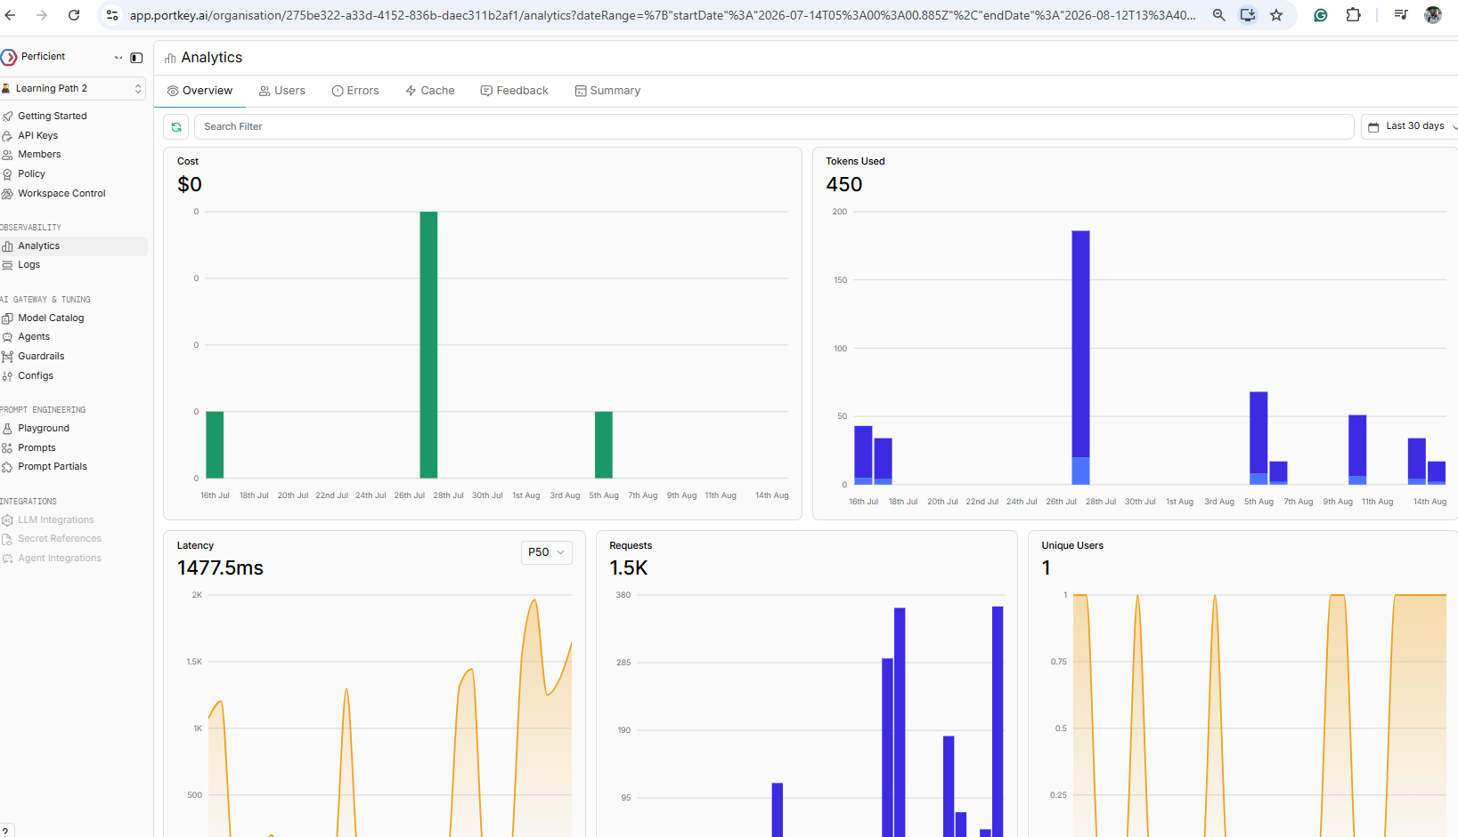
Portkey usage

Slide 11
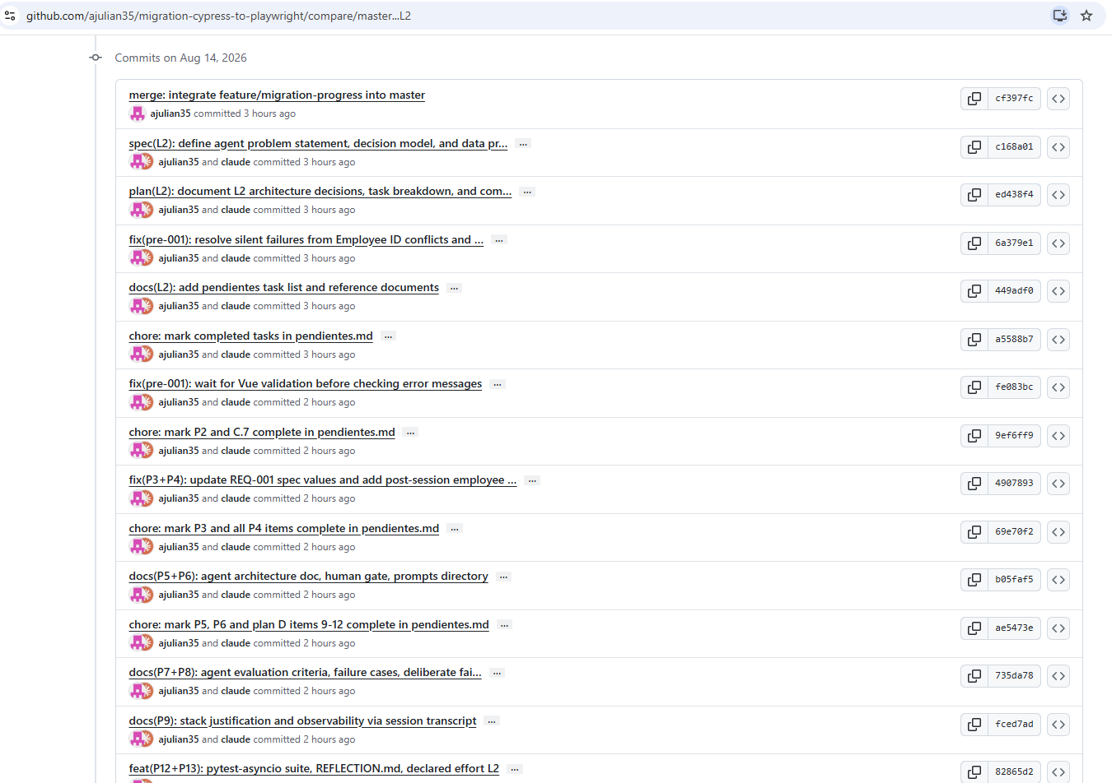
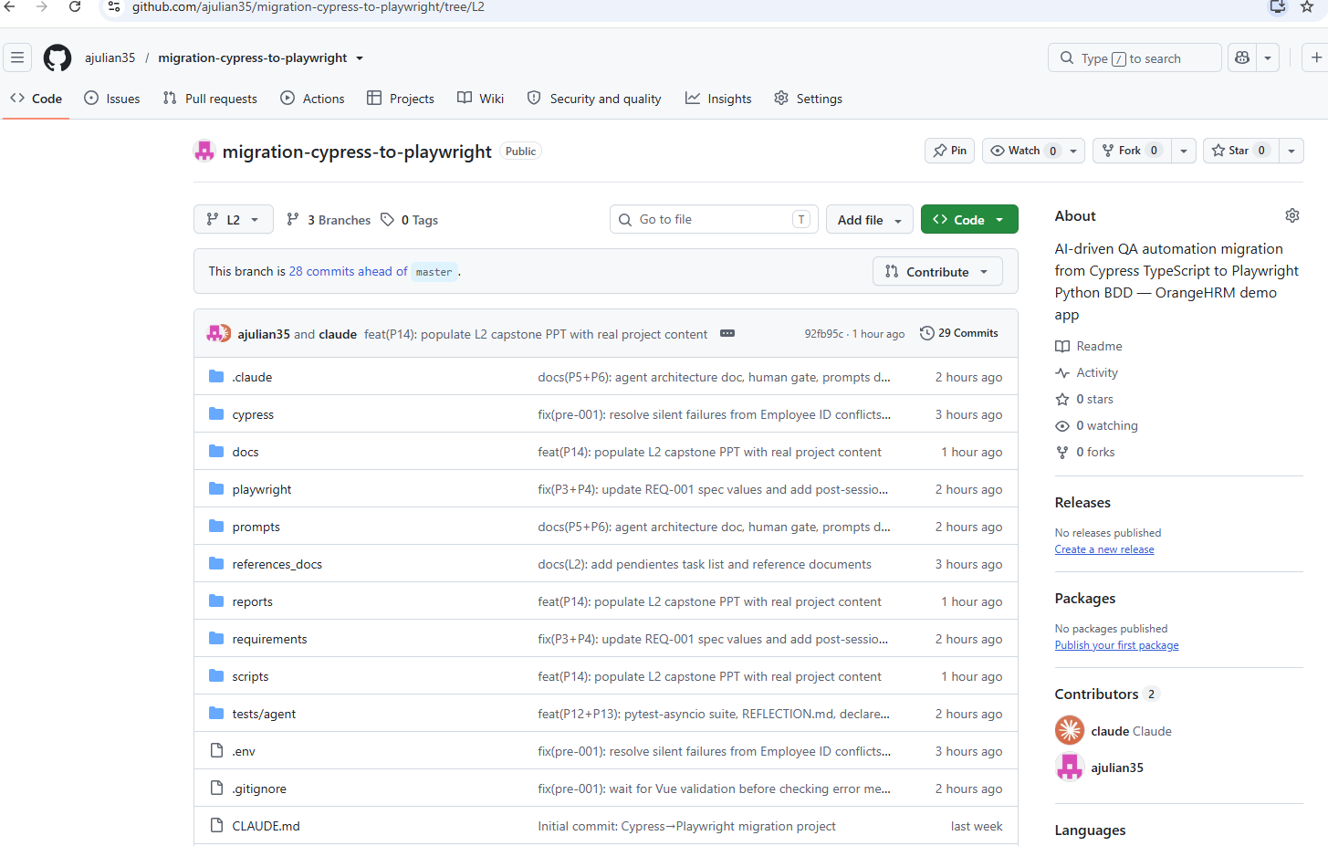
GitHub - https://github.com/ajulian35/migration-cypress-to-playwright/tree/L2

Slide 12
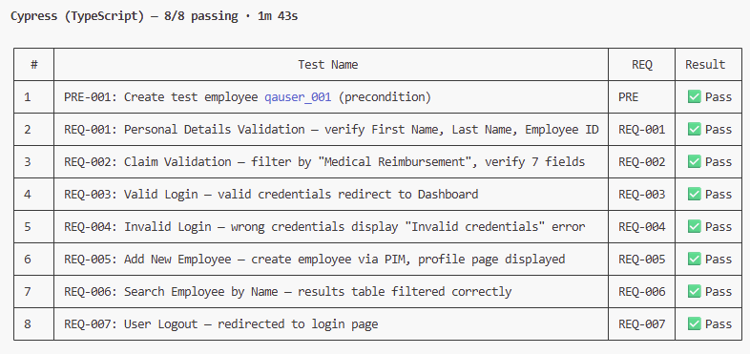
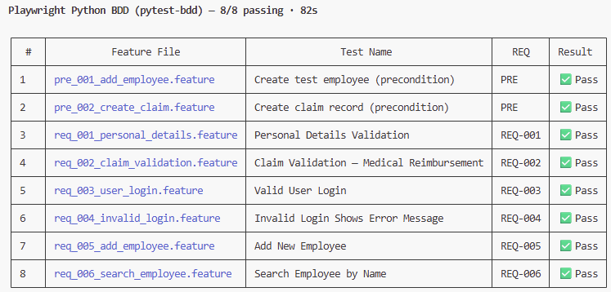
Results
Cypress
Playwright

Slide 13
The Rubric — 5 Topics
Each topic scored 0–30. Demonstrate at least 3. Clear at 70 / 150.
Competency topic | What earns top marks (25–30) | Max
Spec-Driven Development | Spec discipline governs agent behaviour and hand-offs, not just a single file. | 30
AI-Powered Development | Advanced Claude Code / Copilot (agent modes, CLI, skills) delivering working software. | 30
LLM Evaluation & Interpretability | Objective evaluation (LLM-as-judge, scored comparisons); data-grounded decisions. | 30
Agent Design, Orchestration & Ops | Multi-agent / multi-step orchestration with failure handling, recovery, observability. | 30
AI Tool Integration & Extensibility | Extended agents via MCP servers, hooks, or custom skills/tools — secure and reusable. | 30
Distinction 25–30
Proficient 18–24
Developing 10–17
Emerging 0–9

Slide 14
My Self-Rating
Score each topic you demonstrated (0–30). Leave blank if not used (min 3 required).
1. Spec-Driven Development
22 / 30
2. AI-Powered Development
26 / 30
3. LLM Evaluation & Interpretability
24 / 30
4. Agent Design, Orchestration & Ops
24 / 30
5. AI Tool Integration & Extensibility
18 / 30
My total: 114 / 150 Clear = 70+ (I demonstrated 5 of 5 topics)

Slide 15
Reflection & Key Takeaway
Complete these sentences
Before this program, I thought AI was a code autocomplete tool - useful for boilerplate but too unreliable for autonomous end-to-end workflows.
Now I see AI as a force multiplier for repetitive, well-defined tasks. However, it can generate code that appears correct at first glance but fails in edge cases that were not encountered during the agent's exploration. That is why tester review remains essential.
My biggest learning
The most valuable skill is not prompting - it is designing the failure handling path. An agent that validates its own tool output and retries with the failure reason embedded is fundamentally different from one that trusts every response.
Confidence using AI at work
One tip for the next cohort
Before: 2 / 10 After: 8 / 10
We should provide greater support for nontechnical individuals and Spanish speakers throughout the development of their capstone projects.
Thank you — Perficient Global AI First Academy

Slide 16
Rubric Validation
Validator use only
1. Spec-Driven Development
____ / 30
2. AI-Powered Development
____ / 30
3. LLM Evaluation & Interpretability
____ / 30
4. Agent Design, Orchestration & Ops
____ / 30
5. AI Tool Integration & Extensibility
____ / 30
Validated total: ____ / 150 Clear = 70+
☐ Yes, Agree — certify
☐ No, Do not certify
Validator signature: __________________ Date: ________
Certification is issued only on "Yes, Agree". A score ≥ 70 is a recommendation, not automatic certification.

